Slide 1

Restaurant Inventory Management

Slide 2
Description
This product uses IoT devices which let you track your inventory in real time. This is particularly useful for perishable items, so you can maintain a fresh supply of these goods while reducing waste.
Quickly identify spoiled products and discard them, optimize and automate the restocking of perishable items, so you always have the ideal amount of fresh items on hand, considering customer health.
Once AI detects the excess food, it will connect with food banks or NGO’s nearby, coordinate and donate the food.

Slide 3
Features
Detect the freshness of the produce
Stock Management
Donation
User Interface

Slide 4
Detect the freshness of the produce
Use Wireless Temperature sensors to maintain refrigerator temperature.
Send an alert if temperature is dropping below or above permitted levels for longer times.
Oxygen and Carbon-dioxide sensor to detect the freshness of fruits and veggies.
Send an alert if the LED changes color indicating the freshness of the produce.

Slide 5
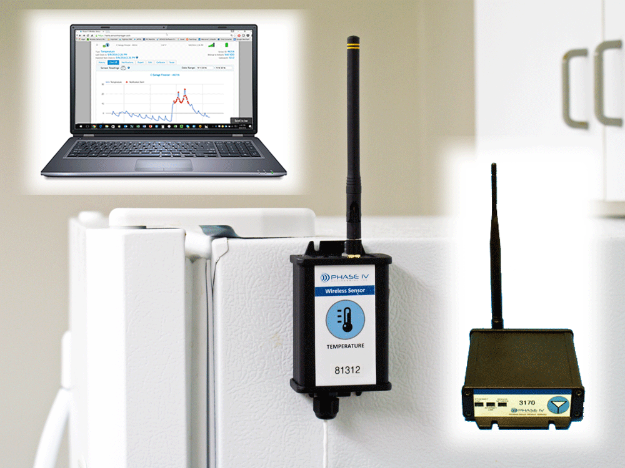
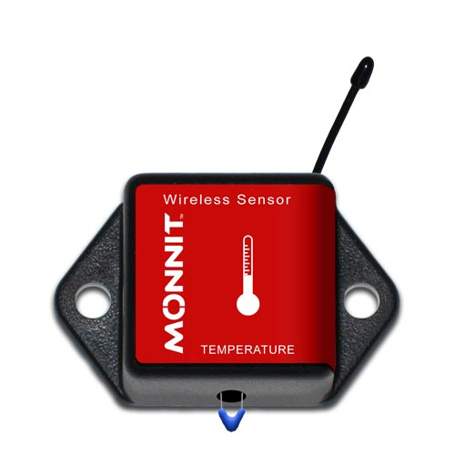
Wireless temperature sensor

Slide 6
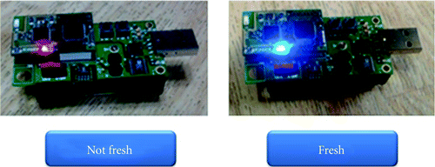
Oxygen and Carbon-dioxide sensor to detect the freshness of fruits and veggies.

Slide 7
Stock Management
The inventory management system allows you to keep up with your stock availability and ensure it is always at an adequate level.
The system gives a notification when the inventory is running low so you can immediately re-order.
With this feature, users can set the minimum amount of stock and turn on the notification that will notify if the inventory has reached the specified minimum level. They can then immediately re-order to the supplier.

Slide 8

Donation
Striving to prepare for variable crowds, restaurants often end up prepping and cooking more than needed and then trashing the leftovers.
To avoid this wastage, we can acknowledge the excess food and try to donate it to nearby NGOs

Slide 9
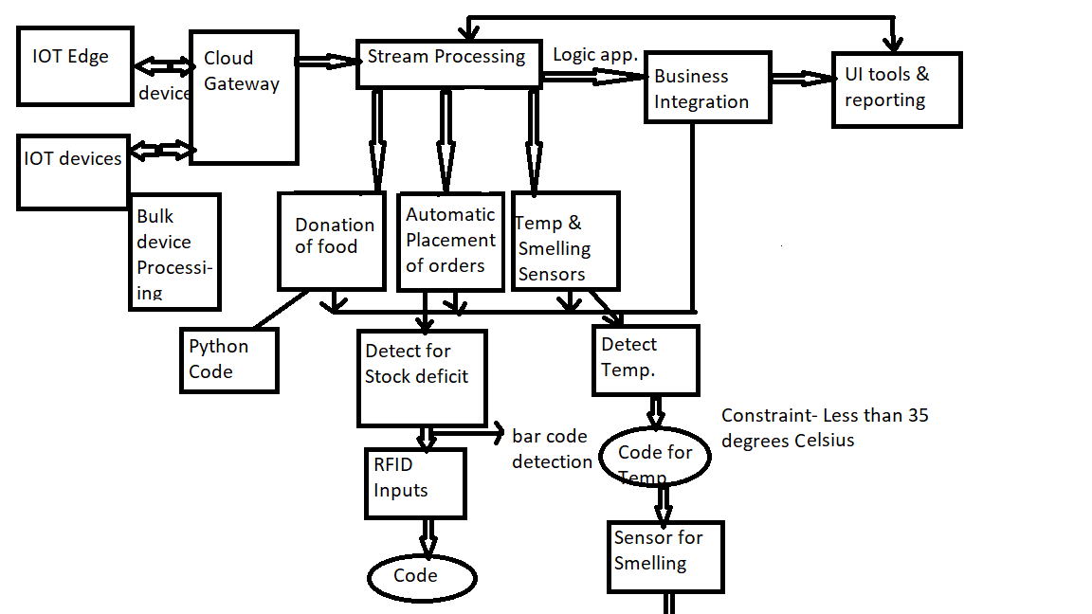

Slide 10
Conclusion
So, in a nutshell, an inventory management system is a system designed to help businesses automate their inventory management.
Cloud-based inventory management software is usually the most preferred option for SMEs, because of its more affordable price, easier implementation, and better flexibility.

